Slide 1
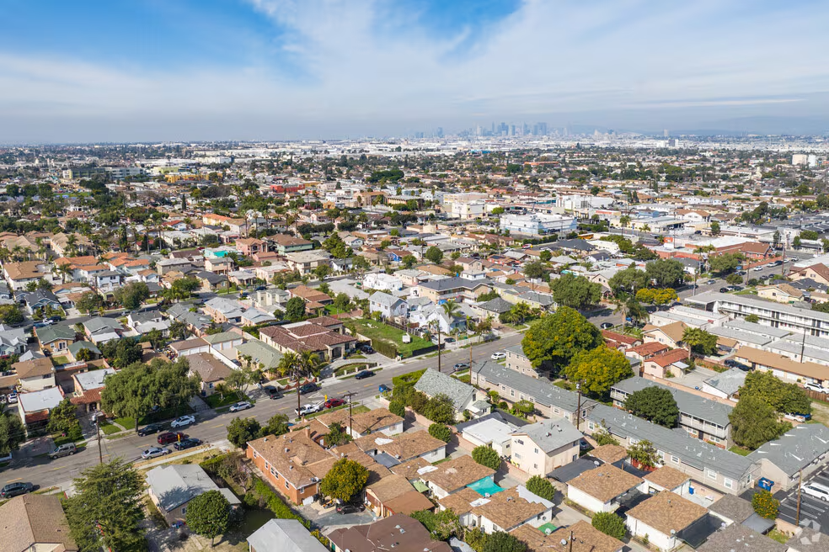

BELL MOBILE HOME PARK IMPACT REPORT
Outreach Overview, Impact Report, and Future Considerations
DATE: January 14, 2026
PRESENTED BY: Michael L. Antwine II,
City Manager

Slide 2
Presentation
Overview
  Timeline
  Purpose of Impact Report
  Financial Issues
  Community Outreach
  Bell Mobile Impact Report
  What’s Next

Slide 3
Timeline

Slide 4
Purpose of Relocation Plan and Impact Report
  Evaluating long-term options; NO SALE has been approved
  Updated the 2020 impact report and prepared a closure plan:
    Gathered information regarding the housing needs and circumstances of the residents
    Ensures long-term housing availability and affordability for the Bell community
    Provides estimates of financial benefits to residents
  Each tenant receives a copy of Notice of impact report and Relocation Benefits

Slide 5

Financial Impact of Mobile Home Parks
  Mobile home parks are currently operating with a financial deficit.
  City uses reserve funds to cover additional costs
  No Rent Increases for last 15 years
  Average Rent is $600 per month
  Past Due Rents is approximately $497,000
    Bell Mobile Home Park:$137,000
    Florence Village Mobile Home Park:$360,000

Slide 6
Community Meetings
  Held community meetings for Resident questions:
    September 22: Bell Mobile & Florence Village
    October 13, October 15, November 6: Bell Mobile
    October 23, November 17: Florence Village
  Meetings had open Q+A where residents could voice their questions, concerns, and comments.
  Relocation specialists, translators, and City staff attended to help answer questions.

Slide 7
Community Outreach
  Maintained website, BellRelocationPlan.com, with resources for residents.
  Notices posted at both parks:
  Appraisals, Interview schedule, Community Meetings, Fact Sheets and Impact report
  Provided Interpretation services at all meetings
  All documents provided in Spanish and English
  Conducted phone and In-person meetings and Interviews.

Slide 8


Creation of Impact Report
Relocation Specialists
  Hired the Office of Project Coordination (OPC) to develop the Relocation Impact Report for Bell Mobile Home Park.
  Households were interviewed to assess relocation needs and answer individualized questions. Information collected during interviews includes:
    Household size and composition
    Ages of household members
    Income and current housing costs
Appraisals
  Hired Geoff Wilhelm, a certified, independent appraiser.
  Provided fair and consistent market valuations of properties for the creation of the impact report.
Notes:
- Relocation Specialists and Appraiser were hired based on experience and through the City's vetting process

Slide 9

Impact Report: Bell Mobile
  OPC successfully interviewed 164 park households to date.
  Appraiser conducted a total of 117 individual inspections:
    77 Homes: A full interior and exterior inspection
    40 Homes: exterior inspection only, as interior access was not granted to the appraiser.
  Impact report available for all residents on the City’s website and project website, BellRelocationPlan.com.
  Total spaces between both mobile home parks is 227 spaces.

Slide 10
Impact Report: Bell Mobile
TABLE 1: Tenant Occupancy Data
Total Residents Responded: 164 | Total Residents Responded: 164
Adults: 108 | Children: 56
Among the Respondents | Among the Respondents
Seniors: 45 Note: May Live w/other Adult family members | Disabled: 31 Note: May Live w/other Adult family members
Notes:
56 respondent households are comprised of a total of 108 adults and 56 children (17 years or younger). With the assumption that there is at least one occupant in the non-interviewed households, there is a total of at least 223 residents within the Park. There is a total of 45 known seniors (62 years of age or older), and 31 residents who reported having a disability as depicted in Table 1 below:

Slide 11
Impact Report: Bell Mobile
TABLE 2: Park Household Incomes
Income Level | # of Households
Extremely Low Income (30% or less of area median income) | 29
Very Low Income (31% - 50% of area median income) | 10
Low Income (51% - 80% of area median income) | 4
Unknown Income | 74
*
Notes:
Of the 56 households interviewed, 43 households provided verbal information regarding gross household income, although it was not complete in some cases. According to income standards the households qualify as follows in Table 2:

Slide 12

Financial Benefits
for Bell Mobile Residents
  Residents may receive the following Financial Benefits:
    Purchase price based on appraised value for home
    Mortgage differential, if purchasing a new Mobile Home
    Covered moving costs, closing costs, and other fees
    42 months of rental assistance (3.5 yrs) same rent
  Maximum amount estimated for owners: up to $250k
  Maximum amount for renters is approximately: up to $40k
  Residents can use Financial Assistance for Downpayment

Slide 13



Resources for
Bell Mobile Residents
  Support from the City of Bell, LAUSD, Gateway Cities Council of Governments, Los Angeles County, and partners to provide residents with housing and social services support including:
    Rental assistance
    Coach relocation
    School placement
    Food insecurities
    Mental health

Slide 14


Replacement Housing Resources
  The report indicates that there is more than sufficient housing available to relocate the tenants at Bell Mobile Park.
  416 mobile homes currently for sale within parks in a 60-mile radius.
  If comparable mobile homes for sale are not available to the displaced owner-occupant Park residents at the time of displacement, additional replacement housing resources may include:
    Townhomes
    Condos
    Multi-family residences
    Single-family residences

Slide 15

What’s Next?
  Continue Appraisals and Interviews during 2026 for both Bell Mobile Park and Florence Village Mobile
    Only 50% participation to date
  Prepare Relocation Plan and Impact Report w/Financial Assistance packages
  City Council Vote on Impact Report
  Issuance of 6-month notice to vacate
  Relocation Benefits and Financial assistance packages distributed to residents
  If sale approved, Future Development Discussion: new housing with designated low-income and senior housing

Slide 16

Questions?

